Slide 1
Lesson 12 Chi-Square Goodness-of-fit test Concepts E214 – Statistical Methods for Engineering

Slide 2
E214 – Statistical Methods for Engineering
Inferential Statistics
Hypothesis Testing
Parameter Estimation
Organize & summarize data collected
Probability and Distributions
Venn Diagram
Discrete Random Variables and Probability Distributions
Probability Distributions
Descriptive Statistics
Continuous Random Variables and Probability Distributions
Binomial Distribution
Poisson Distribution
Normal Distribution
Exponential Distribution
Tree Diagram
L12
A more detailed topic tree on Hypothesis Testing will be given from P08 onwards
2

Slide 3
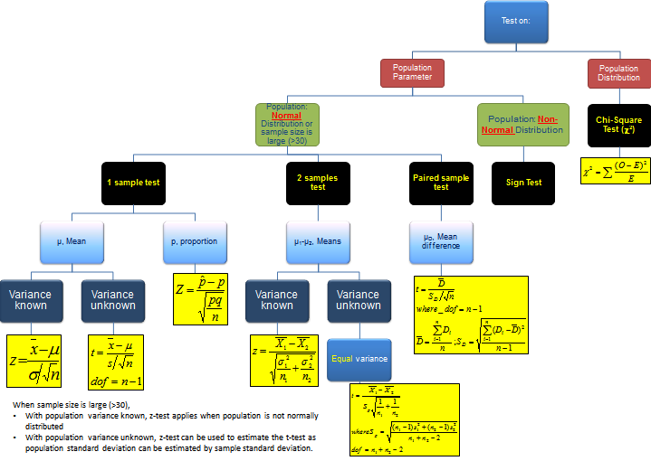
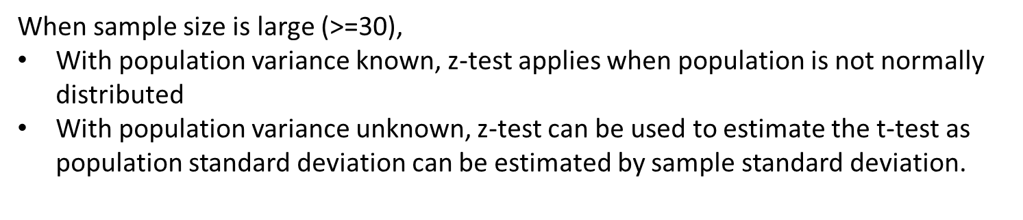
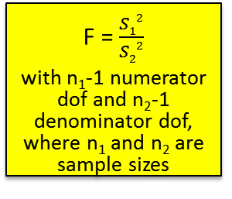
Topic Tree for Hypothesis Testing
ANOVA
A tool to compare the means of several (3 or more) populations with a single test.
L12
2 samples test on variance
σ₁² – σ₂²
F = $\frac{S12}{S22}$
with n₁-1 numerator dof and n₂-1 denominator dof, where n₁ and n₂ are sample sizes
3

Slide 4
Goodness-of-Fit Test
Previously, we conducted statistical hypothesis testing to test single population parameters (e.g. population means, proportions, etc.) or compare multiple population parameters.
However, sometimes we are interested to find out whether a theoretical probability distribution model can be used to fit a given population.
We can conduct a Goodness-of-Fit test to make conclusions whether or not a certain probability distribution model is suitable for the population.
The essence of this test is to obtain sample data from the population under study, and then to determine if there is a good fit between the probability distribution model and the actual observed sample data.
4

Slide 5
Goodness-of-Fit Test
If there is an agreement, then we can conclude that the population follows the probability distribution model and vice versa.
This test is based on how good a fit we have between:
the frequency of occurrence of observations in an observed sample, and
the expected frequencies obtained from the hypothesized probability distribution model
[Example] Some situations in which we can conduct the Goodness-of-fit test:
We suspect that the distribution of heights of all Republic Poly’s students follows a normal distribution with mean 165 cm and standard deviation 8.4cm.
We wish to test whether the distribution of different flavors of sweets in a bag packaged by a factory is random.
We wish to use a Poisson distribution model with mean 0.3 to fit the number of car accidents along AYE per month but not sure if it is appropriate.
5

Slide 6
Goodness-of-Fit Test
Assumptions for Chi-Square Goodness-of-Fit Test
(i) The experiment satisfies the properties of a multinomial experiment
(ii) The expected frequency in each category must be at least 5 (if not, combine any adjacent categories so that the expected frequency becomes at least 5)
The Chi-Square test statistic in the Goodness-of-Fit Test follows the Chi-Square distribution with *k-1 degrees of freedom, where k = number of categories
*This only applies when there are no estimated population parameters for the hypothesized distribution model.
6
Notes:
To elaborate on “multinomial experiment”, lecturers can consider showing concepts slide 8

Slide 7
The χ² Test Statistic
The χ² Test Statistic measures the amount of disagreement between the observed data and the expected data.
The degrees of freedom = Number of categories – 1
where, the sum is over all categories, with k being the number of categories, O_{j} being the observed frequency count and E_{j} the expected frequency count in category j.
Note: j = 1, 2, …, k
7

Slide 8
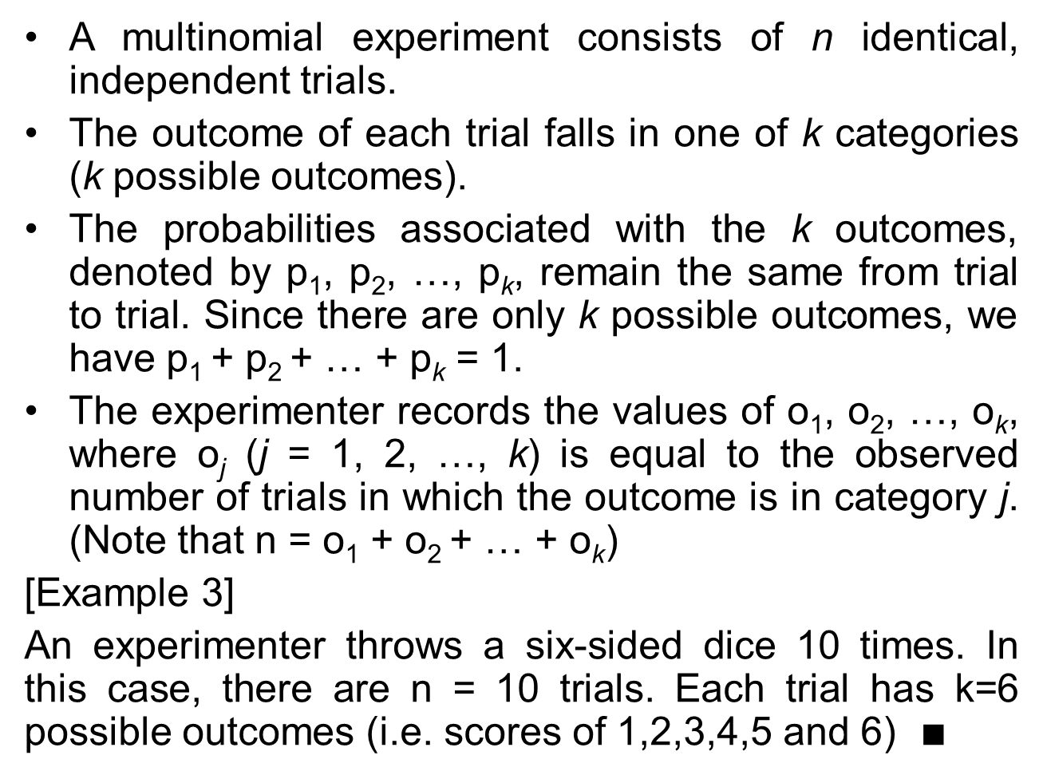
Multinomial Experiment
A multinomial experiment consists of n identical, independent trials.
The outcome of each trial falls in one of k categories (k possible outcomes).
The probabilities associated with the k outcomes, denoted by p₁, p₂, …, p_{k}, remain the same from trial to trial. Since there are only k possible outcomes, we have p₁ + p₂ + … + p_{k} = 1.
The experimenter records the values of o₁, o₂, …, o_{k}, where o_{j} (j = 1, 2, …, k) is equal to the observed number of trials in which the outcome is in category j. (Note that n = o₁ + o₂ + … + o_{k})
[Example 3]
An experimenter throws a six-sided dice 10 times. In this case, there are n = 10 trials. Each trial has k=6 possible outcomes (i.e. scores of 1,2,3,4,5 and 6) $∎$
8

Slide 9
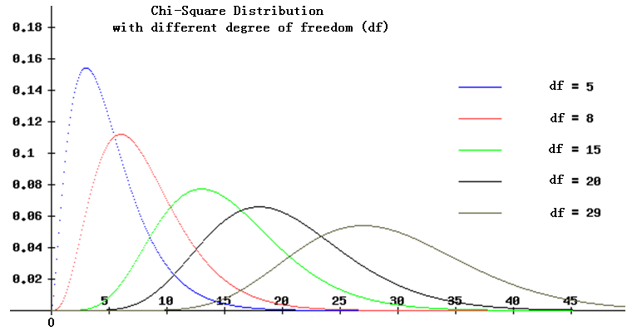
χ² Distribution and PDF Curve
Source:
http://www.egwald.ca/statistics/sampling.php
The curve begins at zero and is right skewed. Chi-square values are either zero or positive.
As the degrees of freedom increase, the PDF curve stretches out along the positive horizontal axis and becomes flatter.
Excel Functions:
CHISQ.DIST.RT(x, degree of freedom) (return right-tail probability of x)
or CHISQ.DIST(x, degree of freedom, 1) (return the left-tail probability of x)
CHISQ.INV.RT(right-tail probability, degree of freedom) (return Chi-square value corresponding to right-tail probability)
or CHISQ.INV(left-tail probability, degree of freedom) (return Chi-square value corresponding to left-tail probability)
9

Slide 10
Why Goodness-of-fit Tests are always Right-tailed?
The idea behind the goodness-of-fit test is like this:
If the observed frequency is close to the corresponding expected frequency (assuming H₀ is true), then the square of the deviation will be small. Hence, the square of the deviation divided by the expected frequency will also be small.
Why do we divide by the expected frequency?
It is to take into account the size of the expected frequency. For example, if square of deviation is 10 but expected frequency is 12, then it is considered big but if the expected frequency is 1200, then it is considered small. Therefore, the expected frequency needs to be taken into account when computing the square of deviation. When we take the square of deviation divided by the expected frequency, we call it the “weighted square of deviation”.
If the total sum of weighted squares of deviations is small, then we cannot reject the claim that these frequencies are calculated using the hypothesized distribution model. Only when the sum increases beyond a certain value, can we conclude that the distribution model is not appropriate. Therefore the goodness-of-fit test is always right-tailed.
10

Slide 11
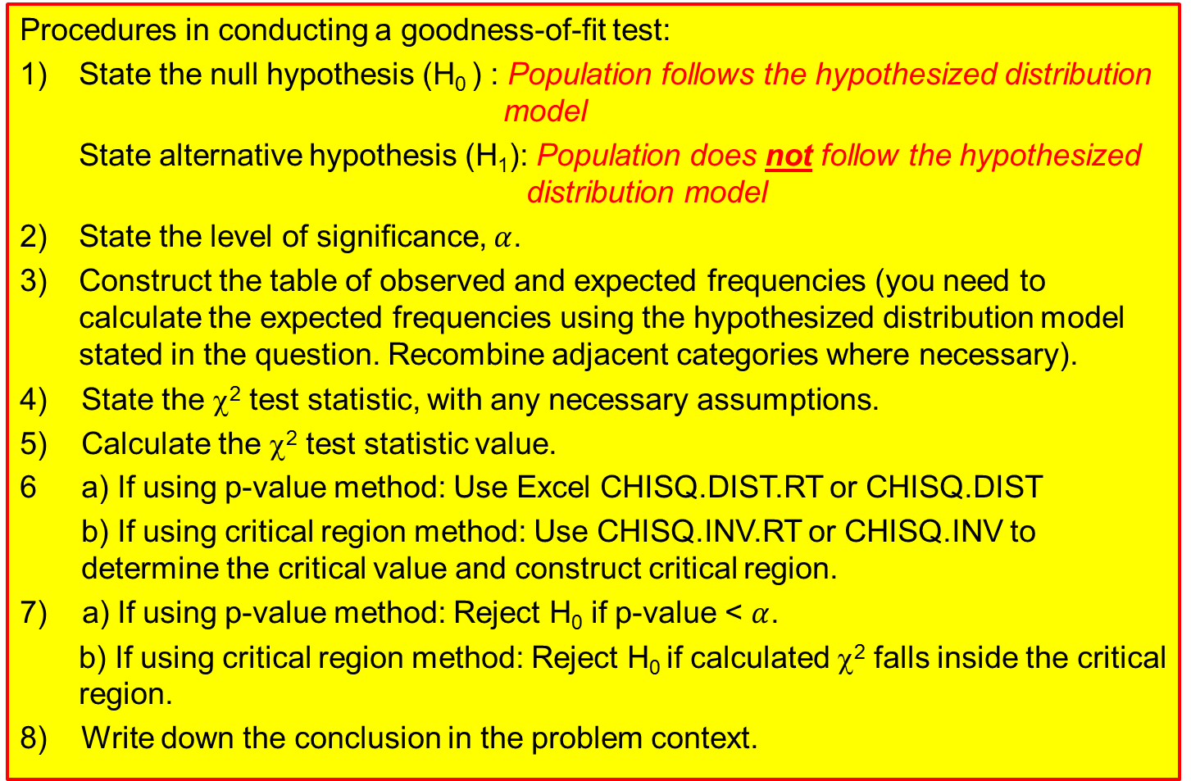
Steps to conduct a χ² Goodness-of-Fit Test
Procedures in conducting a goodness-of-fit test:
1) State the null hypothesis (H₀ ) : Population follows the hypothesized distribution model
State alternative hypothesis (H₁): Population does not follow the hypothesized distribution model
2) State the level of significance, $α$.
3) Construct the table of observed and expected frequencies (you need to calculate the expected frequencies using the hypothesized distribution model stated in the question. Recombine adjacent categories where necessary).
4) State the χ² test statistic, with any necessary assumptions.
5) Calculate the χ² test statistic value.
6 a) If using p-value method: Use Excel CHISQ.DIST.RT or CHISQ.DIST
b) If using critical region method: Use CHISQ.INV.RT or CHISQ.INV to determine the critical value and construct critical region.
7) a) If using p-value method: Reject H₀ if p-value < $α$.
b) If using critical region method: Reject H₀ if calculated χ² falls inside the critical region.
8) Write down the conclusion in the problem context.
Goodness-of-Fit tests are always
right-tailed tests!
11

Slide 12
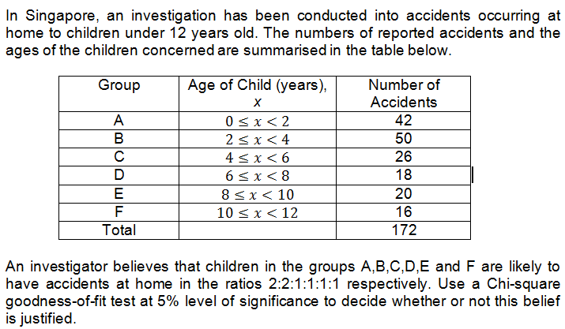
Example
12

Slide 13
Example
Step 1: State the null and alternative hypotheses.
H₀: Children in the groups A,B,C,D,E,F are likely to have accidents at home in the ratios 2:2:1:1:1:1 respectively
H₁: Children in the groups A,B,C,D,E,F are not likely to have accidents at home in the ratios 2:2:1:1:1:1 respectively
Step 2: State the level of significance.
Level of significance = 0.05
13

Slide 14
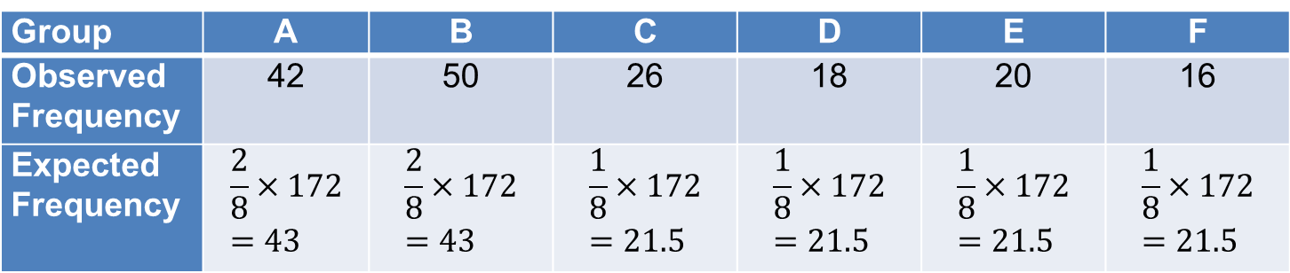

Example
Step 3: Construct the table of observed and expected frequencies.
Step 4: State the Chi-square test statistic.
Test statistic: $χ^{2}=\sum_{all categories}{\frac{{\left(O_{i}−E_{i}\right)}^{2}}{E_{i}}}\sim χ_{5}^{2}$
Group | A | B | C | D | E | F
Observed Frequency | 42 | 50 | 26 | 18 | 20 | 16
Expected Frequency | $$\frac{2}{8}×172=43$$ | $$\frac{2}{8}×172=43$$ | $$\frac{1}{8}×172=21.5$$ | $$\frac{1}{8}×172=21.5$$ | $$\frac{1}{8}×172=21.5$$ | $$\frac{1}{8}×172=21.5$$
Note:
Check that the expected frequency in each category is at least 5. If not, we need to combine any adjacent cells together so that the total expected frequency is at least 5.
14

Slide 15
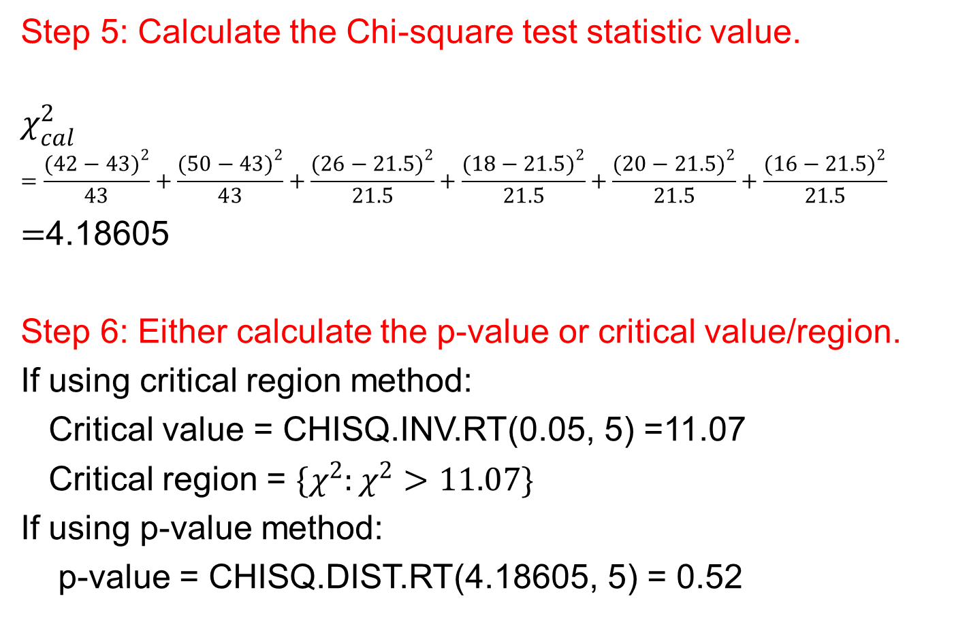
Example
Step 5: Calculate the Chi-square test statistic value.
$$χ_{cal}^{2}$$
$$=\frac{{(42−43)}^{2}}{43}+\frac{{(50−43)}^{2}}{43}+\frac{{(26−21.5)}^{2}}{21.5}+\frac{{(18−21.5)}^{2}}{21.5}+\frac{{(20−21.5)}^{2}}{21.5}+\frac{{(16−21.5)}^{2}}{21.5}$$
$=$4.18605
Step 6: Either calculate the p-value or critical value/region.
If using critical region method:
Critical value = CHISQ.INV.RT(0.05, 5) =11.07
Critical region = $\{χ^{2}:χ^{2}>11.07\}$
If using p-value method:
p-value = CHISQ.DIST.RT(4.18605, 5) = 0.52
15

Slide 16
Example
Step 7: Decide whether or not to reject H₀.
Decision:
If using critical region method: Since calculated test statistic falls outside the critical region, do not reject H₀.
If using p-value method: Since p-value > level of significance, do not reject H₀.
Step 8: Write down a formal conclusion in the problem context.
Conclusion:
There is insufficient evidence at the 5% level of significance to conclude that the children in the groups A,B,C,D,E,F are not likely to have accidents at home in the ratios 2:2:1:1:1:1 respectively.
16

Slide 17
Learning Objectives
Calculate the expected number of outcomes to fall into the various categories of a multinomial experiment
Conduct a Chi-square goodness of fit test for suitability of a given distribution model
17

Slide 18
E-Learning Video
You are strongly encouraged to watch the e-learning video prepared for L12 to enhance your understanding of the main learning objectives.
You can access the e-learning video from the following link:
https://drive.google.com/file/d/0B0VVo-P5cYtqaUp2enlPUERYV3c/edit?usp=sharing
18

